Slide 1
TCP Data Flow

Slide 2
Stream Delivery Service
TCP provides process-to-process communication using port numbers
It is a stream-oriented protocol.
It allows the sending process to deliver data as a stream of bytes and allows the receiving process to obtain data as a stream of bytes.
TCP creates an environment in which the two processes seem to be connected by an imaginary “tube” that carries their bytes across the Internet.
The sending process produces (writes to) the stream of bytes and the receiving process consumes (reads from) them.

Slide 3
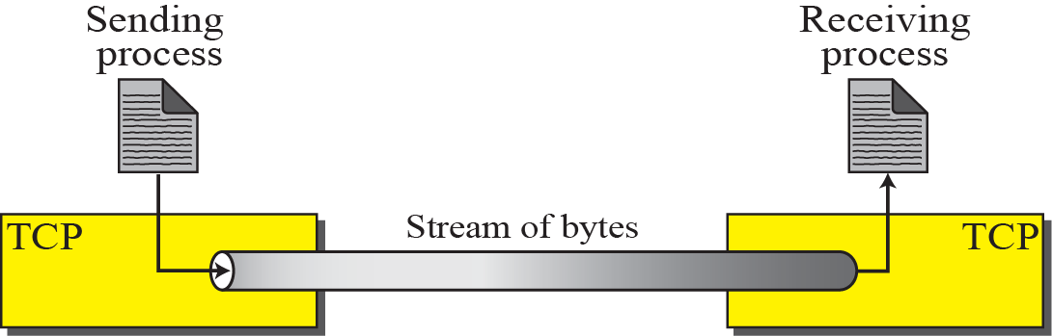
Stream delivery

Slide 4
Whenever an entity produces items and another entity consumes them, there should be a balance between production and consumption rates.
If the items are produced faster than they can be consumed, the consumer can be overwhelmed and needs to discard some items.
If the items are produced slower than they can be consumed, the consumer should wait; the system becomes less efficient.
Flow control is related to the first issue.
We need to prevent losing the data items at the consumer site.

Slide 5
Delivery of items from a producer to a consumer can occur in one of the two ways: pushing or pulling.
If the sender delivers items whenever they are produced without the prior request from the consumer the delivery is referred to as pushing.
If the producer delivers the items after the consumer has requested them, the delivery is referred to as pulling

Slide 6
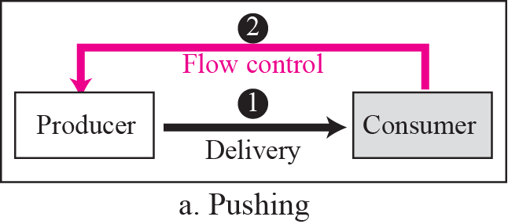
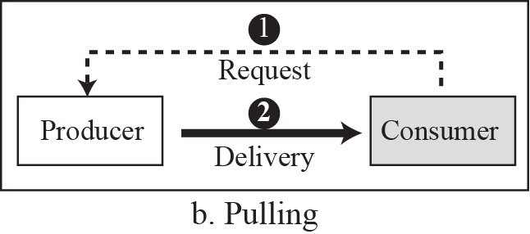
Pushing or pulling

Slide 7
Sending and Receiving Buffers
Because the sending and the receiving processes may not necessarily write or read data at the same rate, TCP needs buffers for storage.
There are two buffers, the sending buffer and the receiving buffer, one for each direction.
One way to implement a buffer is to use a circular array of 1-byte locations as shown in figure.

Slide 8
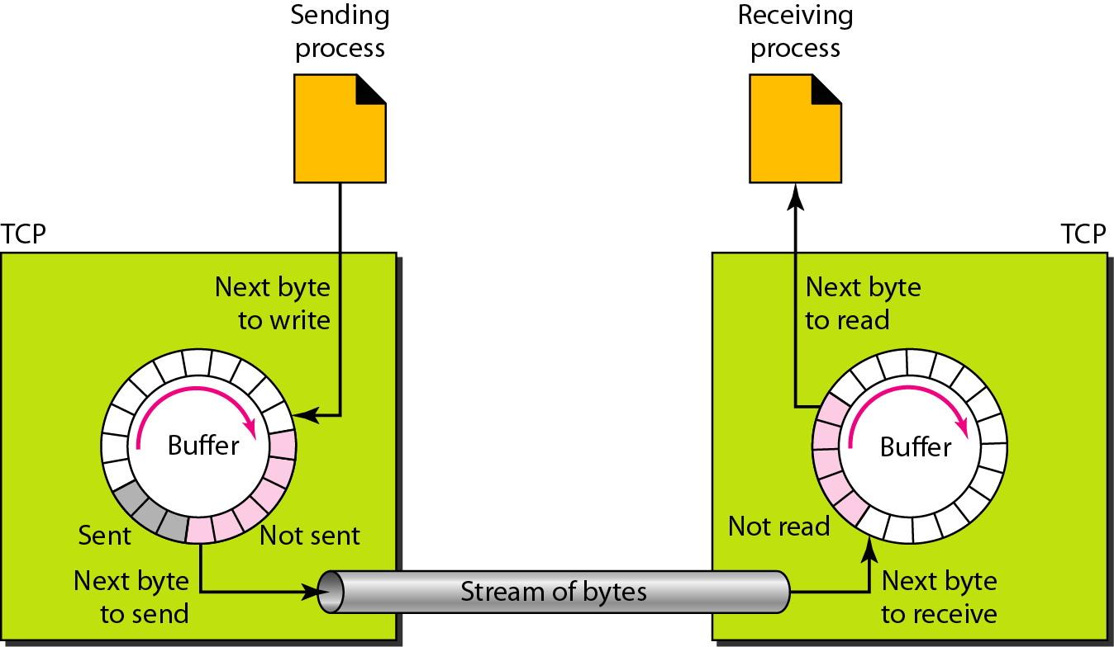
Sending and receiving buffers

Slide 9
The figure shows the movement of the data in one direction.
At the sender, the buffer has three types of chambers.
White section – contains empty chambers that can be filled by the sending process (producer).
Coloured area - holds bytes that have been sent but not yet acknowledged. The TCP sender keeps these bytes in the buffer until it receives an acknowledgment.
Shaded area - contains bytes to be sent by the sending TCP.
After the bytes in the coloured chambers are acknowledged, the chambers are recycled and available for use by the sending process

Slide 10
The operation of the buffer at the receiver is simpler.
The circular buffer is divided into two areas (shown as white and coloured).
The white area contains empty chambers to be filled by bytes received from the network.
The coloured sections contain received bytes that can be read by the receiving process.
When a byte is read by the receiving process, the chamber is recycled and added to the pool of empty chambers.

Slide 11
Segments
The IP layer, as a service provider for TCP, needs to send data in packets, not as a stream of bytes.
At the transport layer, TCP groups a number of bytes together into a packet called a segment.
TCP adds a header to each segment (for control purposes) and delivers the segment to the IP layer for transmission.
The segments are encapsulated in an IP datagram and transmitted.
This entire operation is transparent to the receiving process.

Slide 12
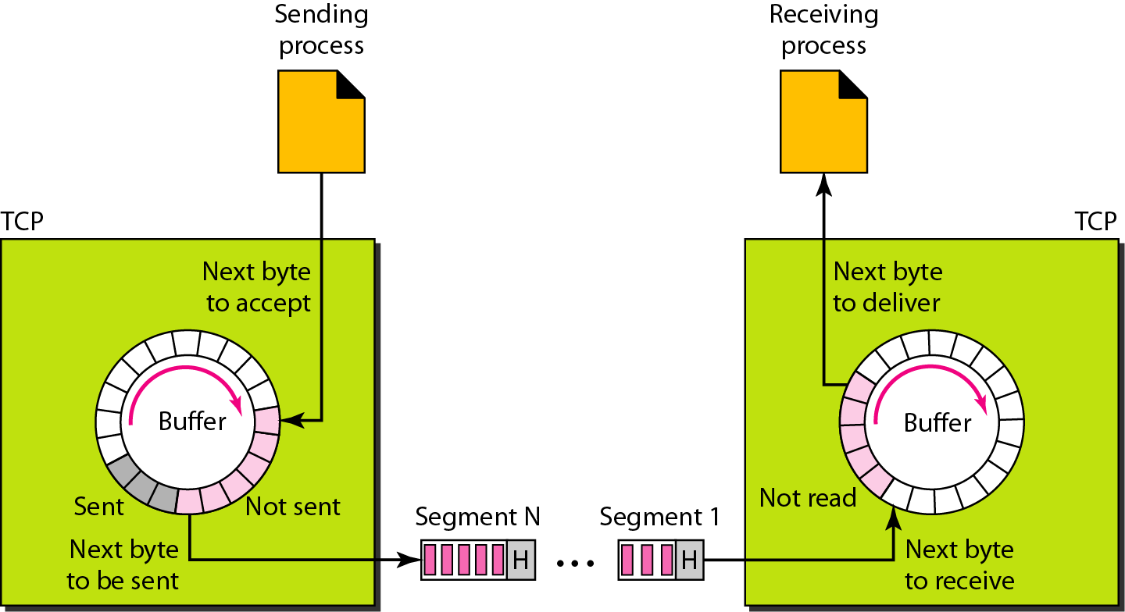
TCP segments

Slide 13
TCP offers full-duplex service, where data can flow in both directions at the same time.
Each TCP endpoint then has its own sending and receiving buffer, and segments move in both directions.
TCP performs multiplexing at the sender and demultiplexing at the receiver.

Slide 14
TCP is a connection-oriented protocol
The TCP segment is encapsulated in an IP datagram and can be sent out of order, or lost, or corrupted, and then resent.
Each may be routed over a different path to reach the destination.
There is no physical connection.
TCP creates a stream-oriented environment in which it accepts the responsibility of delivering the bytes in order to the other site.
TCP is a reliable transport protocol. It uses an acknowledgment mechanism to check the safe and sound arrival of data.

Slide 15
Connection Management in TCP

Slide 16
TCP Connection Establishment
TCP uses a three-way handshake to open a connection:
(1) ACTIVE OPEN: Client sends a segment with
SYN bit set
port number of client
initial sequence number (ISN) of client
(2) PASSIVE OPEN: Server responds with a segment with
SYN bit set ( counts as one byte)
initial sequence number of server
ACK for ISN of client
(3) Client acknowledges by sending a segment with:
ACK ISN of server

Slide 17
Three-Way Handshake

Slide 18
Three-Way Handshake

Slide 19
Why is a Two-Way Handshake not enough?
Will be discarded as a duplicate SYN
When aida initiates the data transfer (starting with SeqNo=15322112355), mng will reject all data.

Slide 20
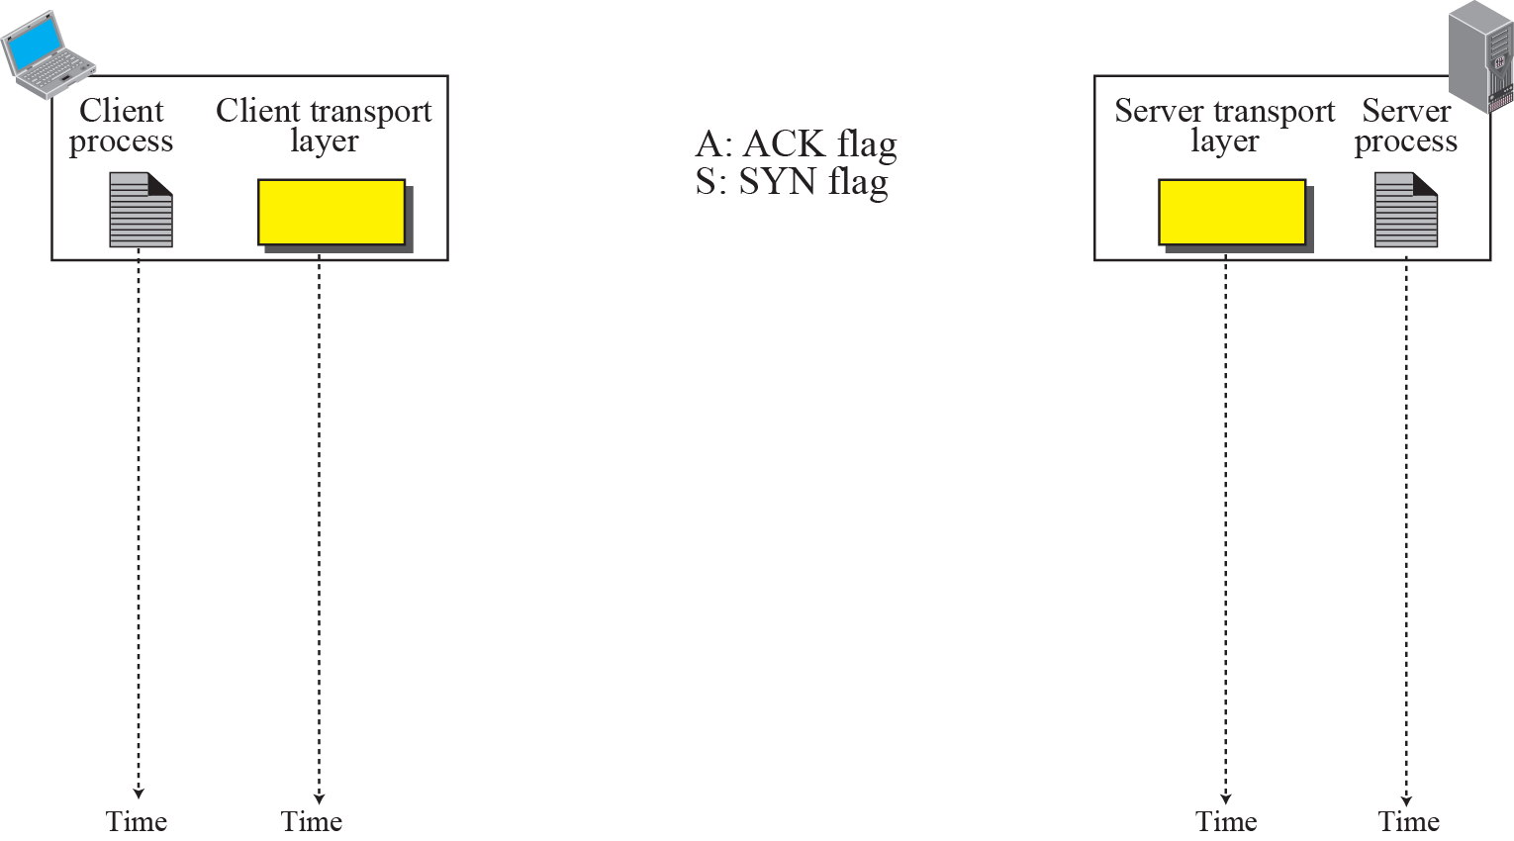

Connection establishment using three-way handshake
Means “no data” !
seq: 8001 if piggybacking

Slide 21
A SYN segment cannot carry data, but it consumes one sequence number.
A SYN + ACK segment cannot carry data, but does consume one sequence number.
An ACK segment, if carrying no data, consumes no sequence number.

Slide 22
Data Transfer
After connection is established, bidirectional data transfer can take place.
The client and server can send data and acknowledgments in both directions. The acknowledgment is piggybacked with the data.
The last segment carries only an acknowledgment because there is no more data to be sent.
The data segments sent by the client have the PSH (push) flag set so that the server TCP tries to deliver data to the server process as soon as they are received.
The segment from the server, on the other hand, does not set the push flag.
Most TCP implementations have the option to set or not set this flag.

Slide 23
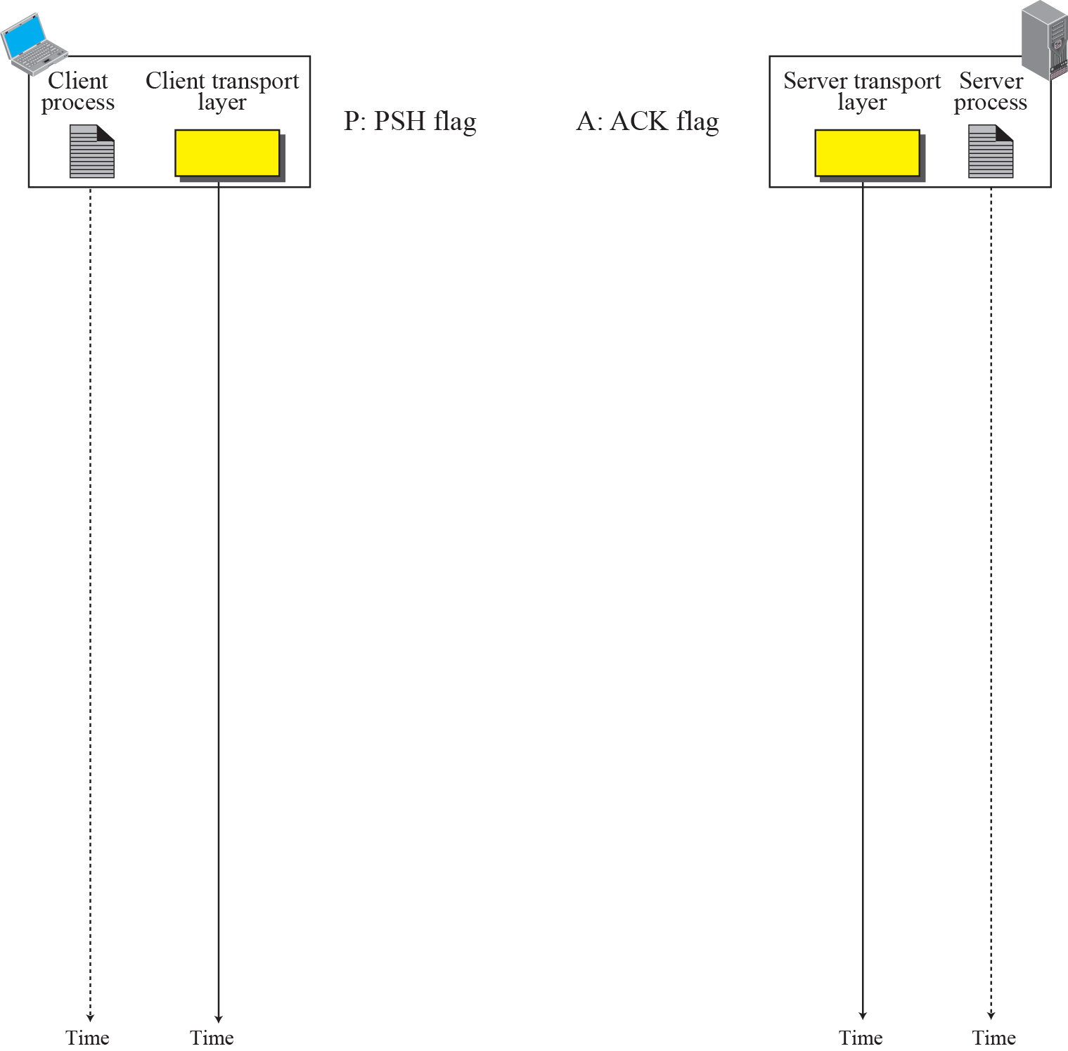
Data Transfer
Pushing data
Urgent data

Slide 24
Pushing Data
The sending TCP uses a buffer to store the stream of data coming from the sending application program. The sending TCP can select the segment size.
The receiving TCP also buffers the data when they arrive and delivers them to the application program when the application program is ready or when it is convenient for the receiving TCP.
This type of flexibility increases the efficiency of TCP.
There are occasions in which the application program has no need for this flexibility (Interactive Programs)
Delayed transmission and delayed delivery of data may not be acceptable by the application program.

Slide 25
TCP can handle such a situation.
The application program at the sender can request a push operation. This means that the sending TCP must not wait for the window to be filled.
It must create a segment and send it immediately.
The sending TCP must also set the push bit (PSH) to let the receiving TCP know that the segment includes data that must be delivered to the receiving application program as soon as possible and not to wait for more data to come.
Although the push operation can be requested by the application program, most current TCP implementations ignore such requests.
TCP can choose whether or not to use this feature.

Slide 26
Urgent Data
TCP is a stream-oriented protocol. This means that the data is presented from the application program to TCP as a stream of bytes.
Each byte of data has a position in the stream. However, there are occasions in which an application program needs to send urgent bytes, some bytes that need to be treated in a special way by the application at the other end.
The solution is to send a segment with the URG bit set. The sending application program tells the sending TCP that the piece of data is urgent.
The sending TCP creates a segment and inserts the urgent data at the beginning of the segment. The rest of the segment can contain normal data from the buffer.
The urgent pointer field in the header defines the end of the urgent data (the last byte of urgent data).

Slide 27
When the receiving TCP receives a segment with the URG bit set, it informs the receiving application of the situation.
How this is done, depends on the operation system.
It is then to the discretion of the receiving program to take an action.
TCP’s urgent data is neither a priority service nor an expedited data service.
Rather, TCP urgent mode is a service by which the application program at the sender side marks some portion of the byte stream as needing special treatment by the application program at the receiver side.

Slide 28
TCP Connection Termination
Each end of the data flow must be shut down independently (“half-close”)
If one end is done it sends a FIN segment. This means that no more data will be sent
Four steps involved:
(1) X sends a FIN to Y (active close)
(2) Y ACKs the FIN,
(at this time: Y can still send data to X)
(3) and Y sends a FIN to X (passive close)
(4) X ACKs the FIN.

Slide 29
TCP Connection Termination

Slide 30
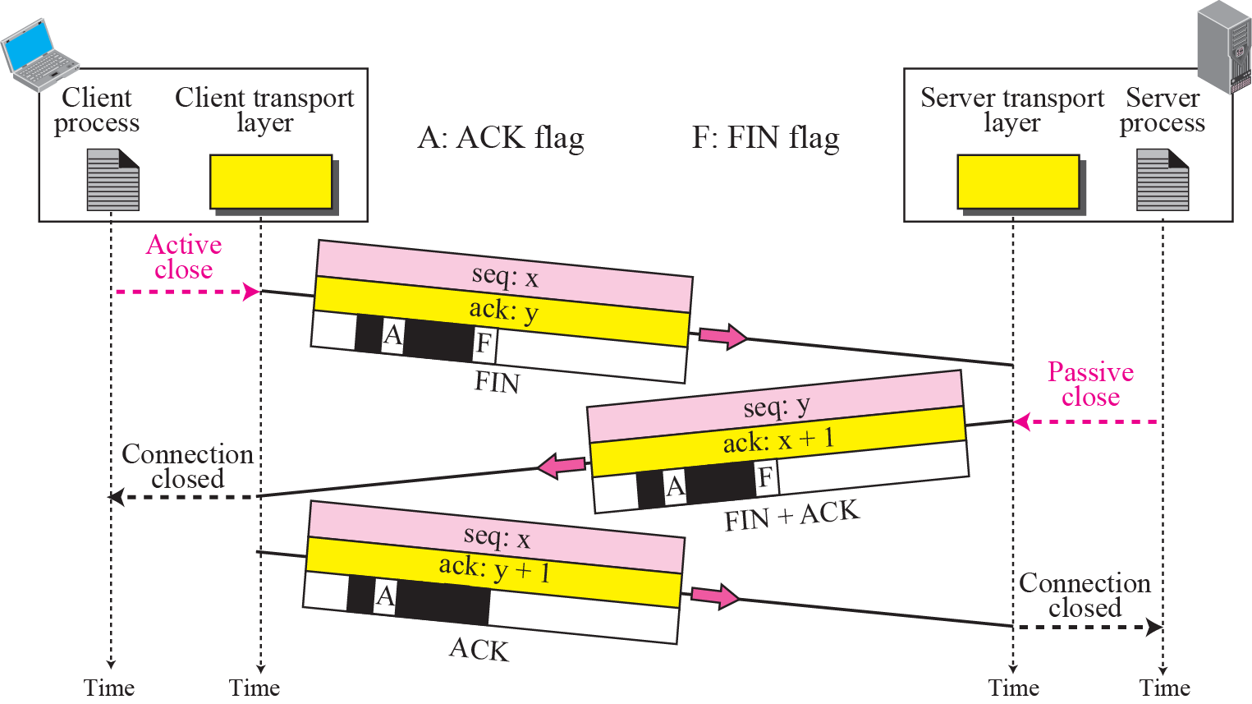
Connection termination using three-way handshake

Slide 31
The FIN segment consumes one sequence number if it does not carry data.
The FIN + ACK segment consumes one sequence number if it does not carry data.

Slide 32
Half Close
In TCP, one end can stop sending data while still receiving data. This is called a half close.
Either the server or the client can issue a half-close request. It can occur when the server needs all the data before processing can begin.
Example – Sorting at the server side, Client can close when server sorts.

Slide 33
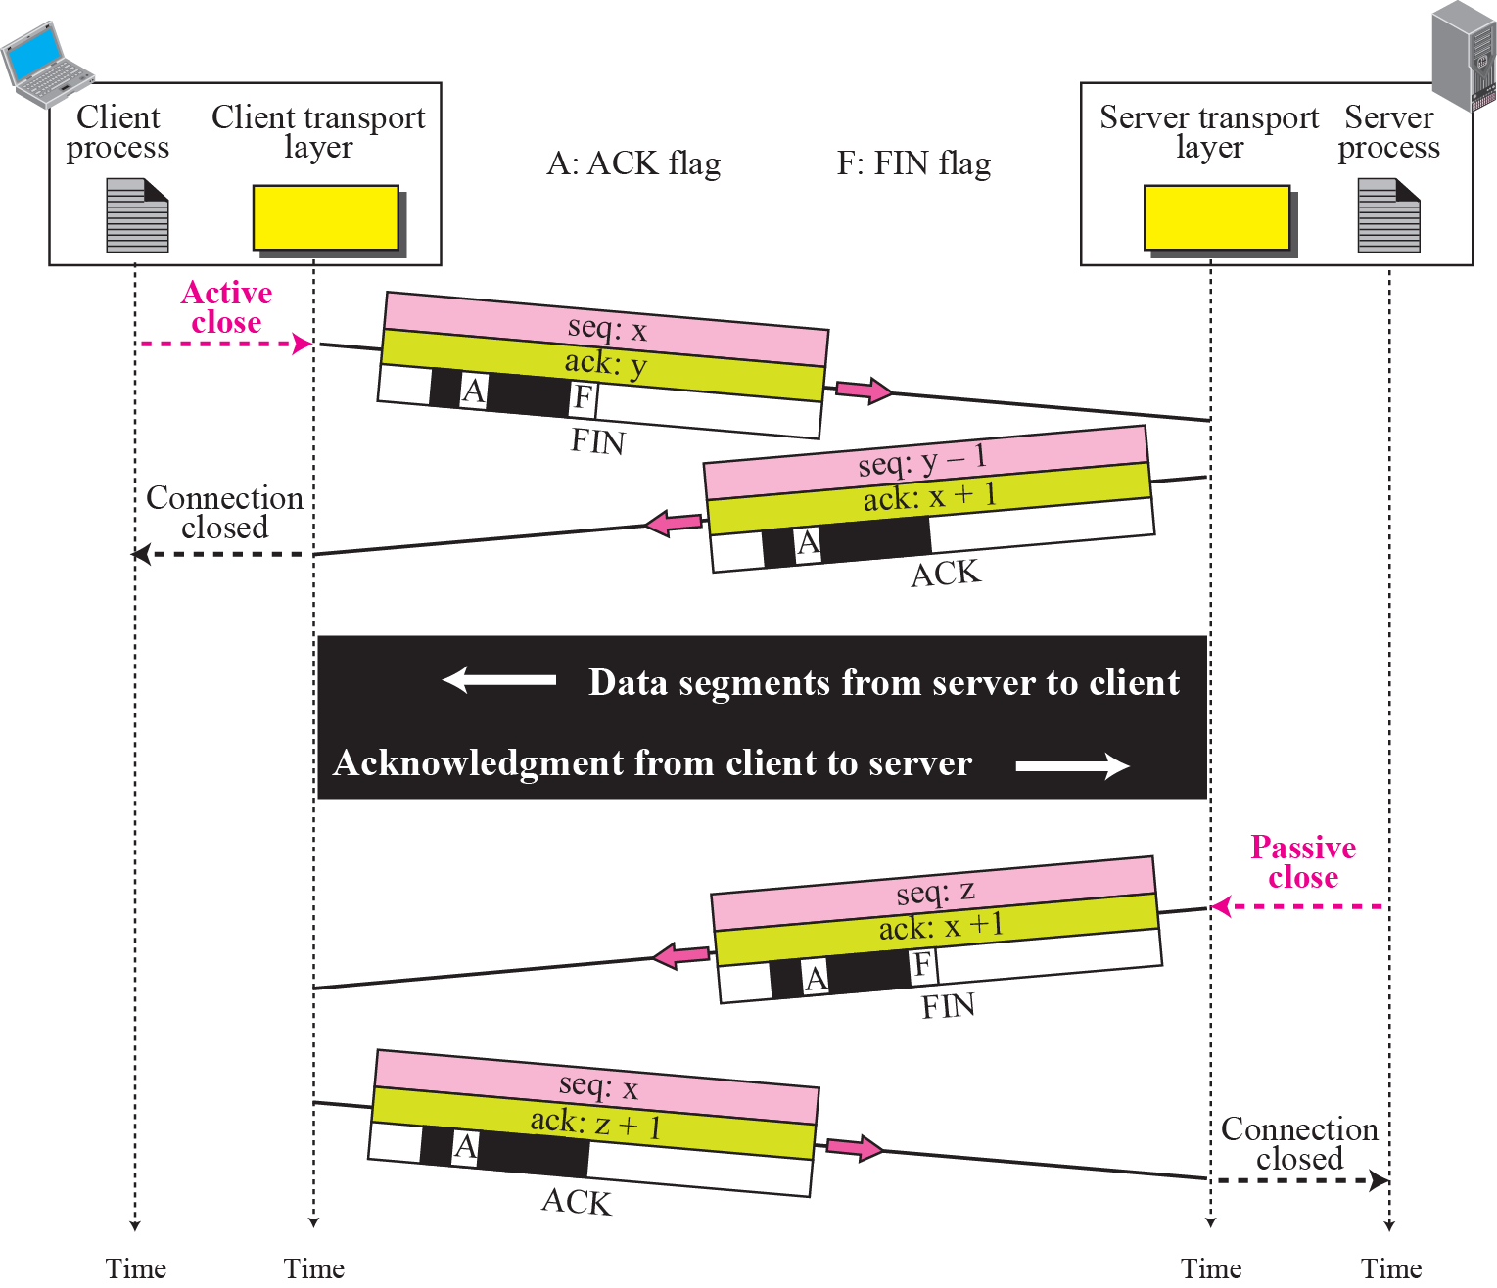
Half-Close

Slide 34
The data transfer from the client to the server stops. The client half-closes the connection by sending a FIN segment.
The server accepts the half-close by sending the ACK segment. The server, however, can still send data.
When the server has sent all of the processed data, it sends a FIN segment, which is acknowledged by an ACK from the client.
After half closing the connection, data can travel from the server to the client and acknowledgments can travel from the client to the server. The client cannot send any more data to the server.

Slide 35
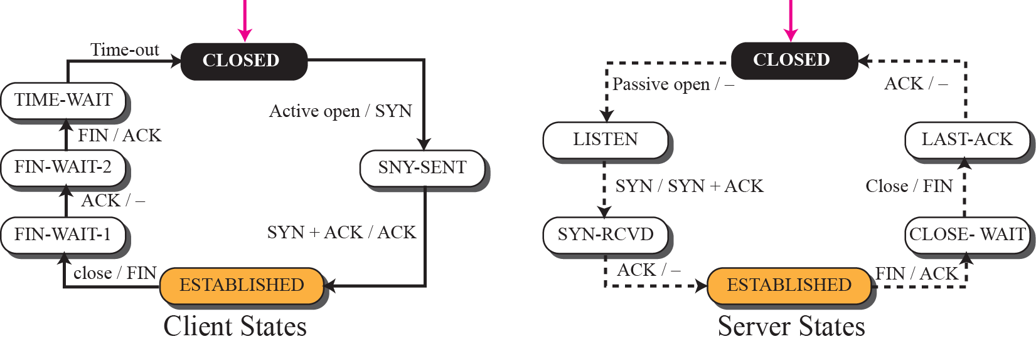
Transition diagram for connection establishment and half-close termination

Slide 36
2MSL Wait State
2MSL Wait State = TIME_WAIT
When TCP does an active close, and sends the final ACK, the connection must stay in in the TIME_WAIT state for twice the maximum segment lifetime.
2MSL= 2 * Maximum Segment Lifetime
Why? TCP is given a chance to resent the final ACK. (Server will timeout after sending the FIN segment and resend the FIN)
The MSL is set to 2 minutes or 1 minute or 30 seconds.

Slide 37
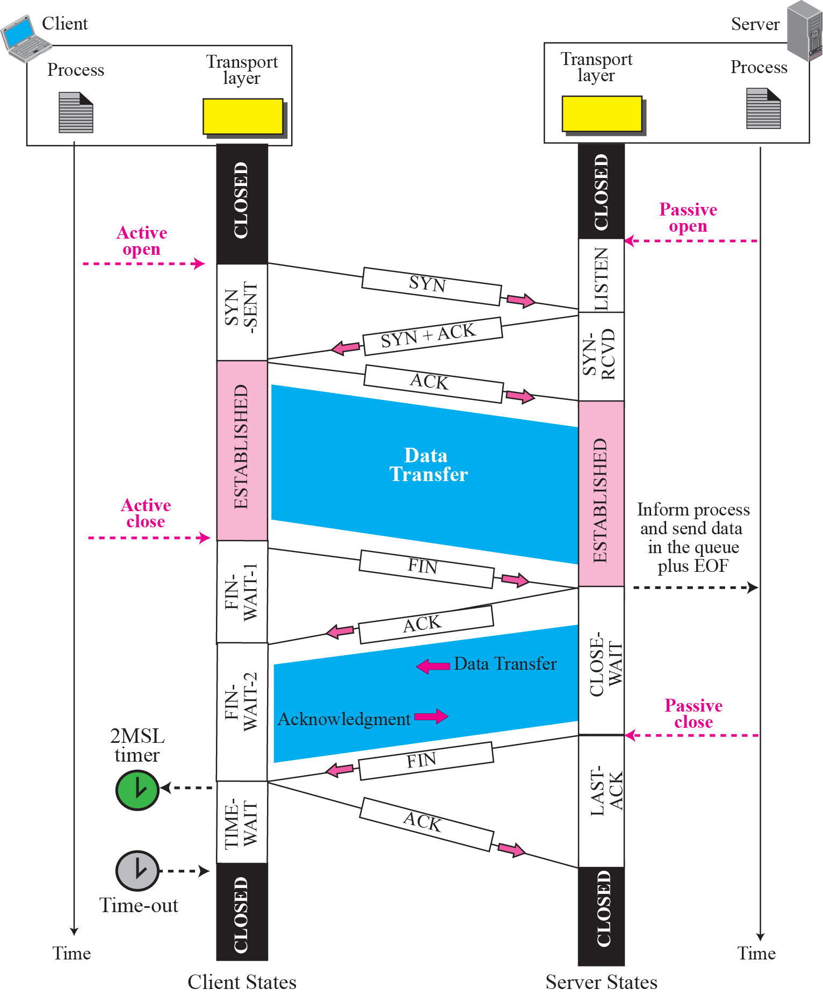
Time-line diagram
1. Enough time for an ACK to be lost and a new FIN to arrive. If during the TIME-WAIT state, a new FIN arrives, the client sends a new ACK and restarts the 2MSL timer
To prevent a duplicate segment from one connection appearing in the next one, TCP requires that incarnation cannot take place unless 2MSL amount of time has elapsed.
Another solution: the ISN of the incarnation is greater than the last seq. # used in the previous connection.

Slide 38
Connection Reset
Resetting connections is done by setting the RST flag
When is the RST flag set?
Connection request arrives and no server process is waiting on the destination port
Abort (Terminate) a connection causes the receiver to throw away buffered data. Receiver does not acknowledge the RST segment
TCP at one end may deny a connection request, may abort an existing connection, or may terminate an idle connection.

Slide 39
Denying a Connection
Suppose the TCP on one side has requested a connection to a non-existent port.
The TCP on the other side may send a segment with its RST bit set to deny the request.
Aborting a Connection
One TCP may want to abort an existing connection due to an abnormal situation. It can send an RST segment to close the connection.
Terminating an Idle Connection
The TCP on one side may discover that the TCP on the other side has been idle for a long time.
It may send an RST segment to end the connection. The process is the same as aborting a connection.

Slide 40
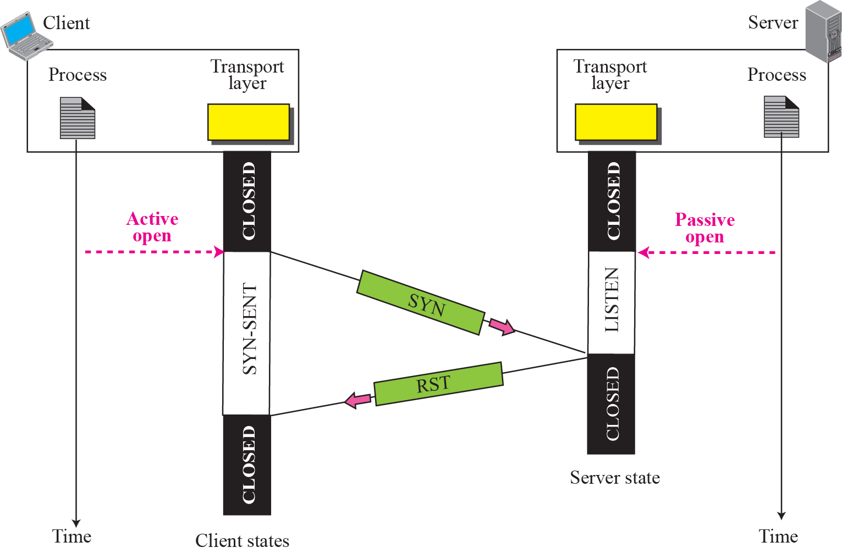
Denying a connection

Slide 41
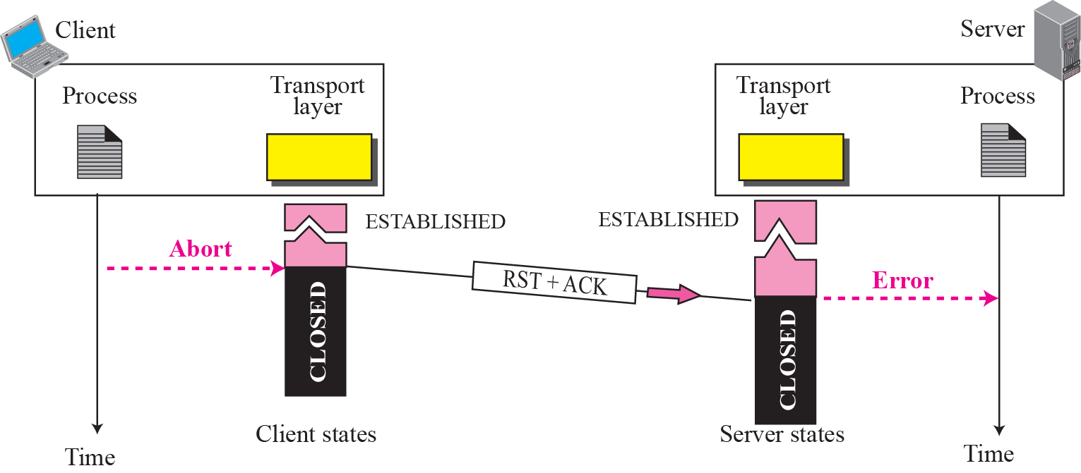
Aborting a connection

Slide 42
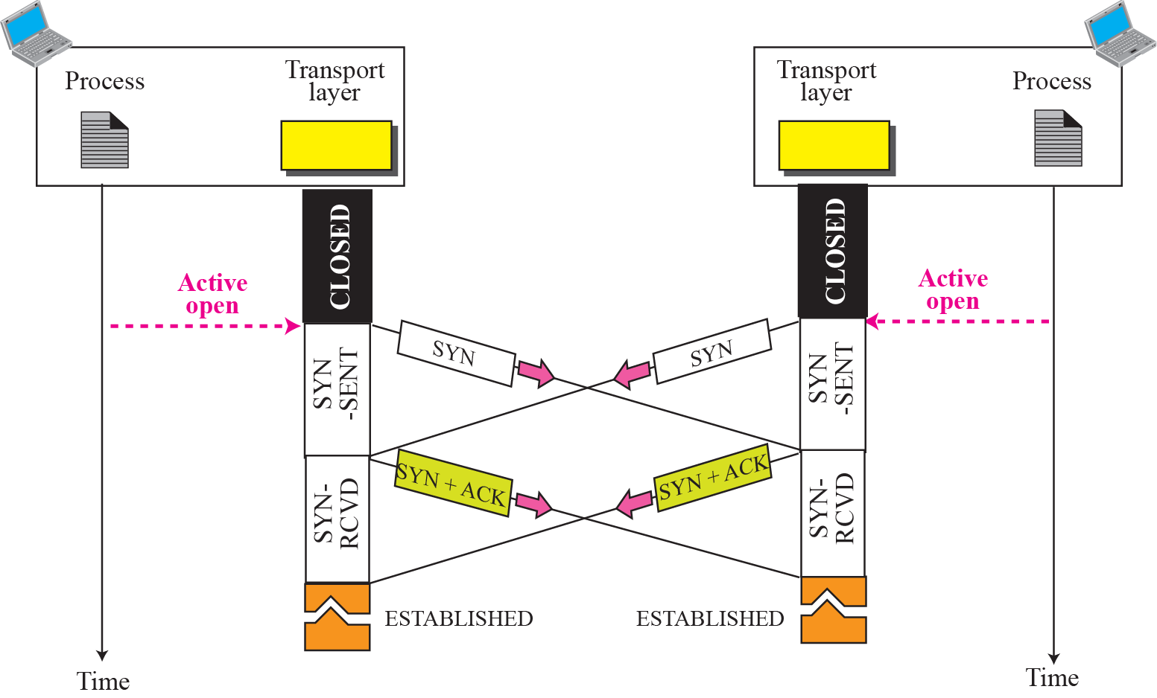
Simultaneous open

Slide 43
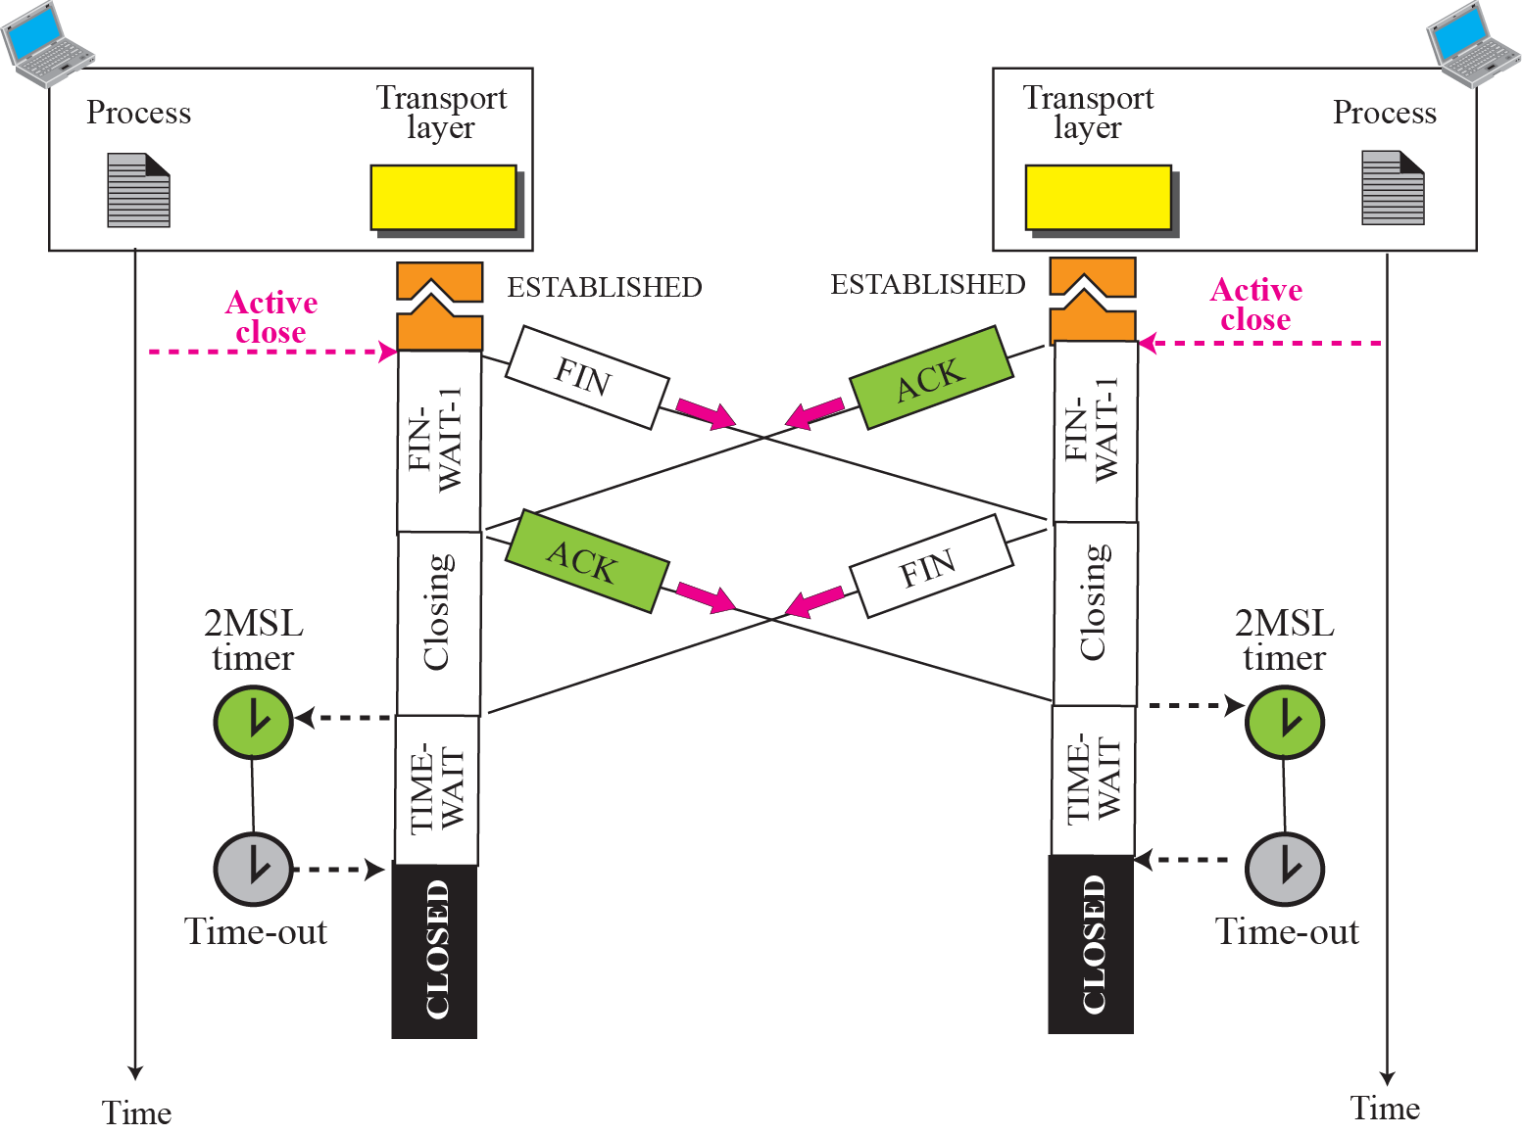
Simultaneous close
ex

Slide 44
TCP States

Slide 45
TCP States in “Normal” Connection Lifetime

Slide 46
TCP State Transition Diagram Opening A Connection

Slide 47
TCP State Transition Diagram Closing A Connection

